Slide 1




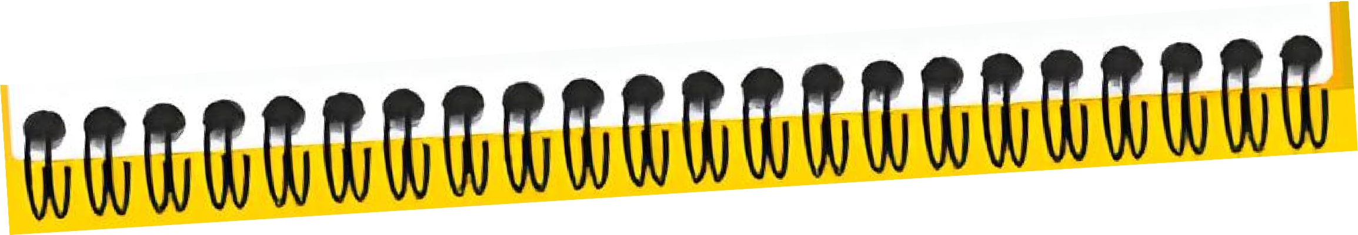



Slide 2





Budapest
Tue | 13.10.
08:30
Wed | 14.10.
09:00
Thu | 15.10.
09:00
Fri | 16.10.
09:00
Workmode Reflection
Agenda for Day 2
Opening
Innovation Theory
Design Thinking
Design Thinking
Individual Homework
Teaming
Lunch Break
Lunch Break
Lunch Break
Lunch Break
Culture
Culture
Individual Homework
Design Thinking
Design Thinking
Facilitation
Design Thinking
Innovation SPOC Session
Reflection 16:00
Reflection
RBHU CEO
Session
18:00
Reflection 18:00
Reflection 18:00
19:00
Welcome Night
18:45
Boat Cruise

Slide 3


STEP 2.2
Empathize - Interviews
RBI Innovation Process

Slide 4








RBI Innovation Process
RBI Innovation Process
1
UNDERSTAND
2
EMPATHIZE
3
IDEATE
4
PROTOTYPE & TEST
5
BUSINESS CASE & PITCH

Slide 5
RBI Innovation Process
RBI Innovation Process
1
UNDERSTAND
2
EMPATHIZE
3
IDEATE
4
PROTOTYPE & TEST
5
BUSINESS CASE & PITCH

Slide 6




2.2
Interviews
Let’s do a quick warm up for your brain.
You have 10 seconds.
Your task is simple: count how many suspicious cancer nodules you can find in this lung X-ray.
Theory

Slide 7
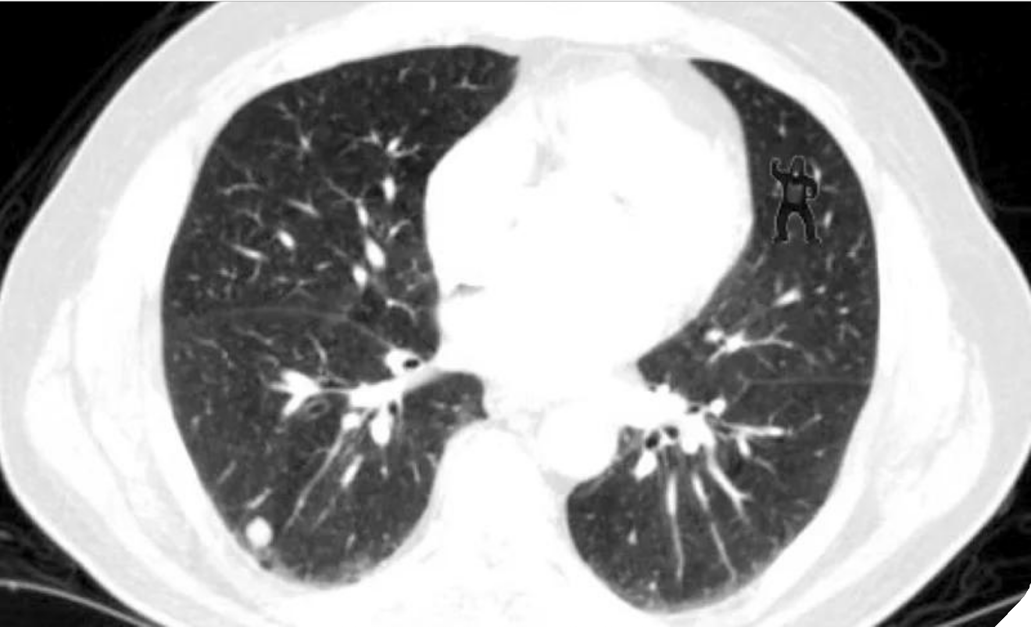
2.2
Interviews
Theory

Slide 8
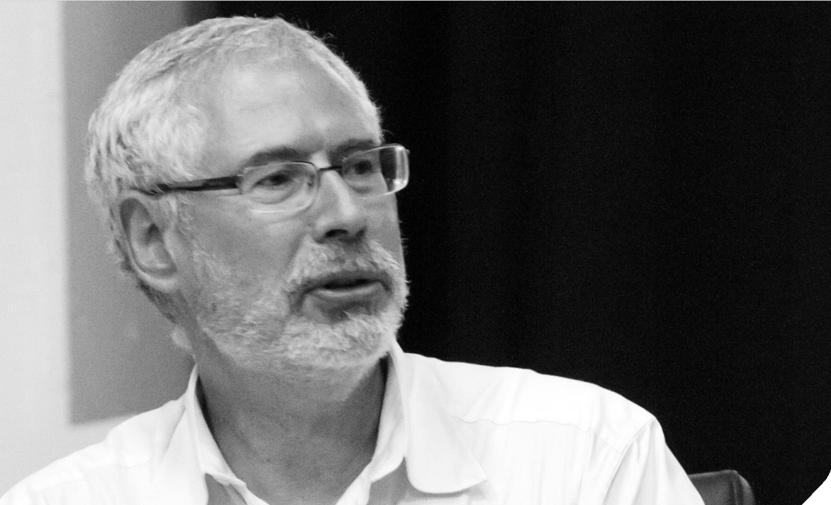
2.2
Interviews
Theory
There are no facts inside your building, so get the heck outside.
Steve Blank

Slide 9
What do we need to consider now?
2.2
Interviews
Theory

Slide 10
(Potential) Team Tasks During the Interview & Research
2.2
Interviews
Explores the pains and needs of the customer
Mindset: Curiosity, not much skepticism, high amount of empathy
No authority ("best friend role")
Asks narrative questions
Interviewer
Theory
Observes the interview and the content
Mindset: neutral, observer, emotional distance
Tries to exploit Inconsistencies
Makes notes during the interview
Quality gate for the analysis
Observer
Researcher
Dive into your data
GPT
Shadower
Stay invisible
Observe and take notes
Look for friction, frustration, switches, time everything

Slide 11


Pro Tips for Interviews
2.2
Interviews
Ask for artifacts
"Can you show me the spreadsheet?" "Can you show me the email?" "Can you show me the report?"
Choose right
setting
Sometimes a walk in the park or coffee chat
reveals way more than the “official” setting where people feel interrogated
Theory
Quantify
Not every pain point matters. Always ask: How often does this happen?
How many people are affected?
How much time does it cost?
Use the recording function + own notes
Record and transcribe everything
Take your own notes Highlight strong quotes as evidence

Slide 12






Your Task: Do Interviews
2.2
Interviews
Final Prep
Conduct your user and expert interviews
90
min
•
Go outside
Work on it
Everybody in the team is expected to do (at least) 1
interview
Optional: Do more desk research or Observe
Remember to record, transcribe (if possible/allowed) or
do a memo afterwards and take notes!
Be back by 10:50!

Slide 13
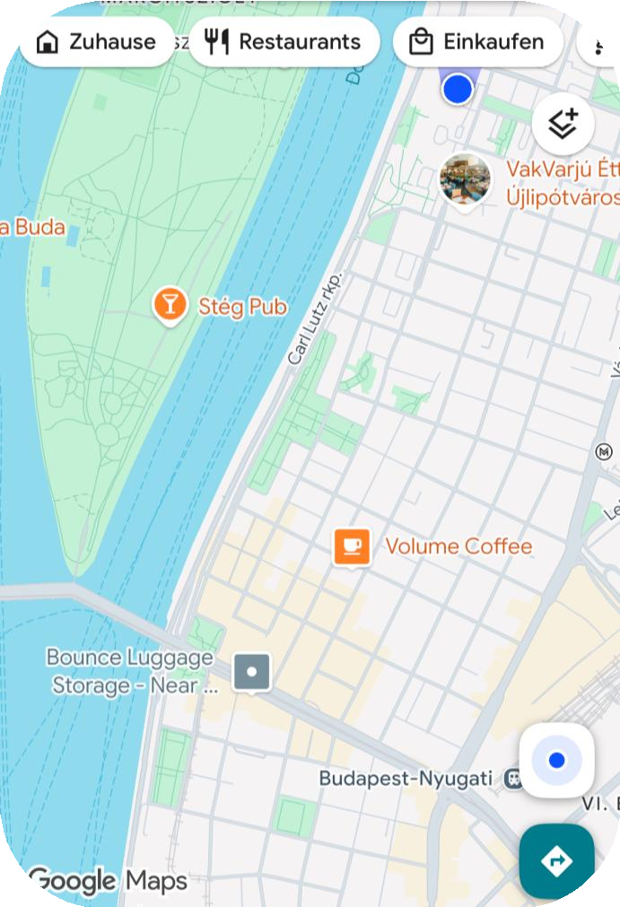
One suggestion
Walking distance around 20 mins
Bus 75 (towards Jászai Mari tér)

Slide 14








Interviews in a Nutshell
2.2
Interviews
Mindset
Listen, be curious and follow interesting signals
Summary
Goals
Tools
Be curious, not convincing
Checklist: Interviews
The interviewee is the expert
Observation, taking perspectives
Listen more than you talk
Interview guideline & empathy interviews
Follow interesting signals and dig
deeper
Research map & desk research

Slide 15



How to Use AI in RBI (for/during Interviews)
2.2
Interviews
Record and transcribe the interview
Quick immediate gap analysis
Ensure every detail is captured by recording and transcribing the entire interview for analysis.
Which assumption or core question did we not cover?
WorHkoown itto use AI
Enhance Conversations with AI Insights
AI can monitor conversations in real time and quietly suggest deeper, insightful questions to enhance your understanding and engagement.
Interview the synthetic user
Engage with the synthetic user you designed to simulate real interactions and gather valuable feedback.

Slide 16









Synthetic Users
2.2
Interviews
Definition
AI-generated user profiles mimic real customer segments by simulating demographics, behaviors, goals, needs, and pain points, using both qualitative and quantitative insights.
When should I use this?
When you have some data and insights on your target
audience that you can feed the AI with.
What can I use it for?
Rapid testing and validation without real user data
Fast, scalable insights for design thinking
Express simulated thoughts, needs, and experiences
Can use uploaded surveys/reviews as a foundation
Impersonate specific user groups from input data
WorHkoown itto use AI
Outcome:
You can expect a very good mimic of your real users, so you can even simulate interviews – it of course
strongly depends on the data quality and quantity the AI gets.

Slide 17




2.2
Interviews
Trigger
You need perspectives and user/expert interviews
Work oSunmitmaHryabits

Slide 18


2.2
Interviews
Desirable Step
Have at least 1 informal research setting, e.g.:
Coffee chats, lunches, events, branch visits
Listen for customer frustrations
Spot complaints hidden between the lines
Work oSunmitmaHryabits

Slide 19


2.2
Interviews
Habit-Stacking
As part of your innovation process and/or work project, have on your checklist the point “have 1 unofficial interview setting”
Work oSunmitmaHryabits

Slide 20


Take your time and note down habits that you are planning to immediately implement after innovation school regarding this step
2.2
Interviews
Reflection Work oSunmitmaHryabits
Page 30

Slide 21


2.2
Interviews

Slide 23


Slide 24
STEP 2.3
Empathize - Synthesize
RBI Innovation Process

Slide 25
RBI Innovation Process
RBI Innovation Process
1
UNDERSTAND
2
EMPATHIZE
3
IDEATE
4
PROTOTYPE & TEST
5
BUSINESS CASE & PITCH

Slide 26
RBI Innovation Process
RBI Innovation Process
1
UNDERSTAND
2
EMPATHIZE
3
IDEATE
4
PROTOTYPE & TEST
5
BUSINESS CASE & PITCH

Slide 27




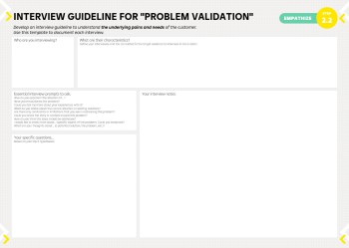
Synthesizing
2.3
Synthesize
Data
Theory
Interviews, Research

Slide 28




1. Unpacking and Clustering
2.3
Synthesize
Try to use linear unpacking when sharing with team members:
What did the data show us?
Who did you talk to?
What did the person tell you about: the actual process, their pains and gains, new other insights? Focus on: quotes, pains, insights.
Theory
Find patterns by using topic clusters, for example:
Pain points and corresponding target groups
Insights on the process or stakeholders involved
Insights on topics that have not been considered
Insights that are relevant for the problem definition

Slide 29
2. Do the Hypotheses Check
2.3
Synthesize
Hypotheses
Validation
Insights / Arguments
Theory
Hypotheses A
Learnings
Hypotheses B
Learnings
Hypotheses C
Learnings

Slide 30
2. Examples: Hypotheses Check
2.3
Synthesize
Hypotheses
Validation
Insights / Arguments
Theory
Customers do not use the mobile banking app because it is too complicated to navigate
The navigation is confusing for new users. Simpler onboarding could increase adoption.
8/10 mentioned
Customers visit branches because they prefer face-to-face service over digital channels
Most visits occur because customers cannot complete certain processes online.
1/10 mentioned
Financing matters, but paperwork and document collection create even greater frustration.
SMEs struggle most with obtaining financing from banks
5/10 mentioned only after asking

Slide 31
3. Collect and Prioritize Pains
2.3
Synthesize
Theory
Must have
Should have
Could have
Won’t have
Absolutely essential elements that must be included at any cost
Important elements that should only be omitted with careful consideration
Desirable elements that would ideally be included if resources allow
Elements that are out-of-scope, unfeasible or actively counterproductive

Slide 32
4. Define Final Focus
2.3
Synthesize
“How Might We” question:
Theory
Intended Action (as an actin verb)
Desired Outco me
Potential User
(as the subject)
How Might We
So That
For
Example:
How might we provide healthier meals for teenagers so that they stay away from junk food

Slide 33
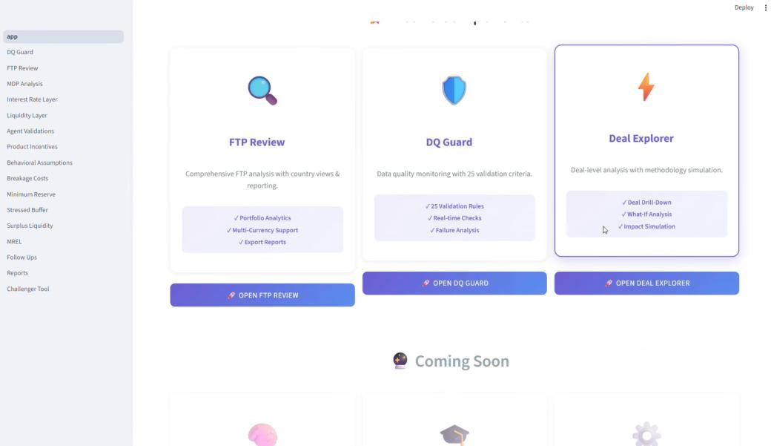

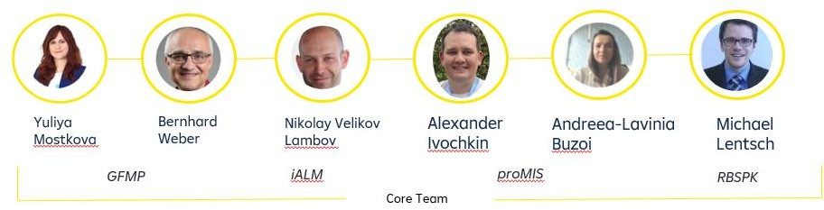

FTP Review Process
2.3
Synthesize
Improve the FTP review process which was heavily manual and relying on qualitative excel questionnaires instead of real data
Synthesize-Step
Interviews revealed a lot of pain points – even more than we initially listed.
The issue: Team was overwhelmed and lost focus
RBI Case Study
Aha-Moment
Prioritized pain points using MoSCoW and focused ideation on the highest-priority challenges
Parked unrelated pain points based on the initial problem scope

Slide 34
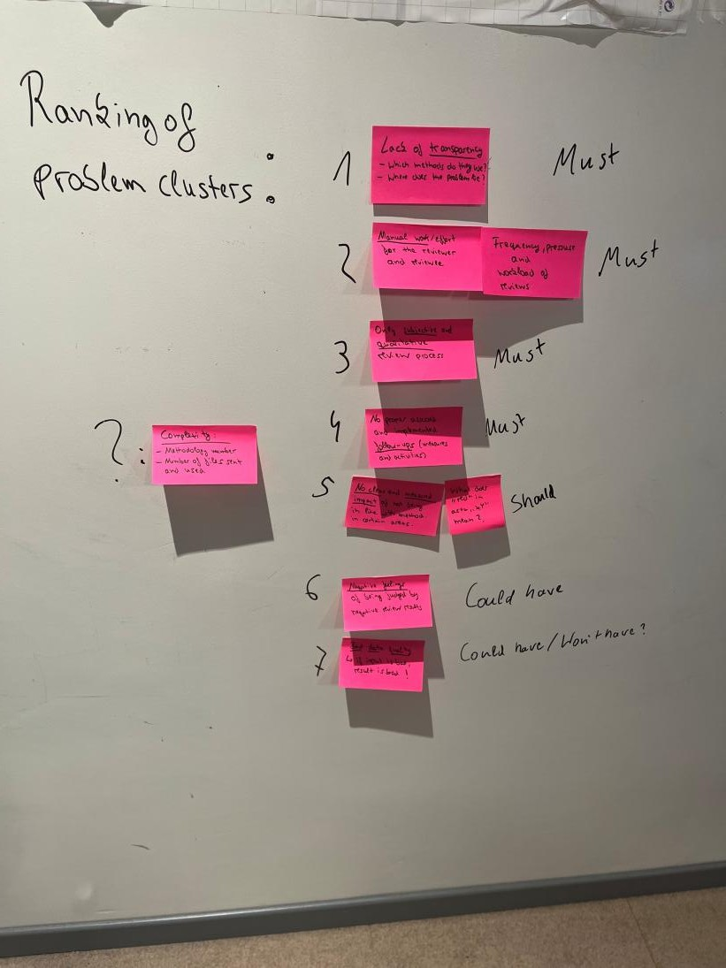
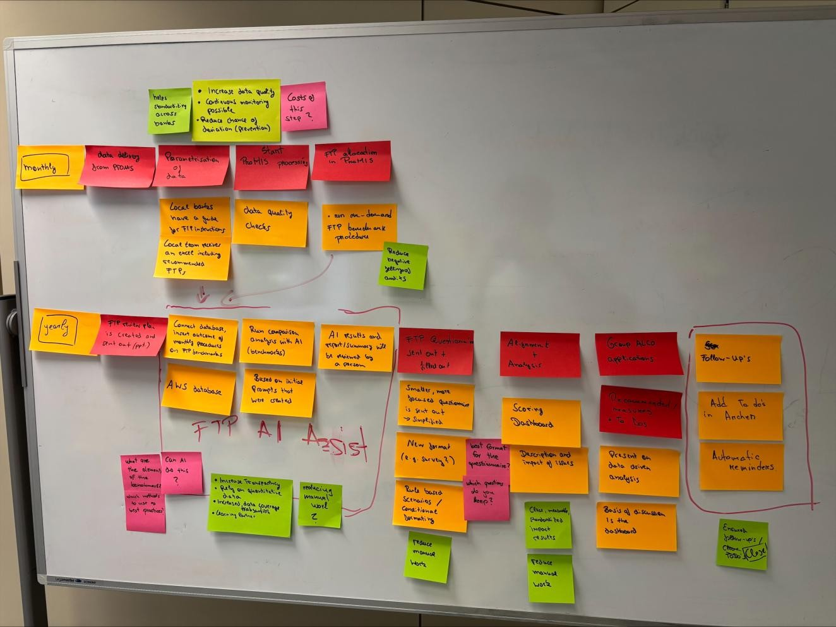
FTP Review Process
2.3
Synthesize
RBI Case Study

Slide 35

How to use AI in RBI
2.3
Synthesize
AI-Powered Transcript Analysis
Automated Content Clustering & Summarization
Upload or link your transcripts and let AI analyze, cluster and summarize them
Extract powerful quotes to make your case
How to use AI
Hypothesis Transformation from Interviews
Ask the AI to transform a hypotheses check based on interview transcripts (& your own notes)
Problem Statement & "How Might We" Drafting
Draft a problem statement, scope of how might we question
In this phase we will tell you how to use AI even before you start working on it, because it can tremendously speed up your analysis

Slide 36




Your Task: Synthesize Problem Space
2.3
Synthesize
10 minutes: Discuss your Interviews & cluster insights without AI quickly
60
min
50 minutes: Do the next steps supported by AI and use the
prompt library for it:
Work Wonoritk on it
Let AI summarize, analyze and interpret additionally.
Check your hypothesis and make sure that it is compared (what is
still missing / what did you learn?)
Review the process on how it should look today and how it is currently lived
Summarize the problem space findings 5.
Formulate a “How Might We” question with help of AI
•
One problem you would like to solve

Slide 37
Synthesize in a Nutshell
2.3
Synthesize
Mindset
Listen to your colleagues, trust your intuition and try to find patterns
Work oSunmitmSaurmy mary
Goals
Tools
Listen attentively to your colleagues
Linear unpacking and personal
takeaways
Structure your learnings
AI analysis, summary of learnings
Check hypotheses status
Insight and pain point prioritization
Find patterns and prioritize Pain Points
Hypotheses Overview
Summarize the problem space, Optional: Iterate
Checklist: Problem Space Summary

Slide 38


2.3
Synthesize
Trigger
You just had an interview.
Work oSunmitHmoawryto usHeaAbIits

Slide 39

2.3
Synthesize
Desirable Step
After each interview, write down:
1 surprising quote
1 pain point
1 key insight
Work oSunmitHmoawryto usHeaAbIits

Slide 40

2.3
Synthesize
Habit-Stacking
Before leaving the meeting or closing Teams, write down your 3 takeaways
Work oSunmitHmoawryto usHeaAbIits
Á la “What you can do in under 2 minutes – do immediately”

Slide 41
Take your time and note down habits that you are planning to immediately implement after innovation school regarding this step
2.3
Synthesize
Reflection Work oSunmitHmoawryto usHeaAbIits
Page 34

Slide 42
2.3
Synthesize

Slide 45
Team Retrospective

Slide 46


What is Culture in the first place?
Innovation Culture
Culture

Slide 47
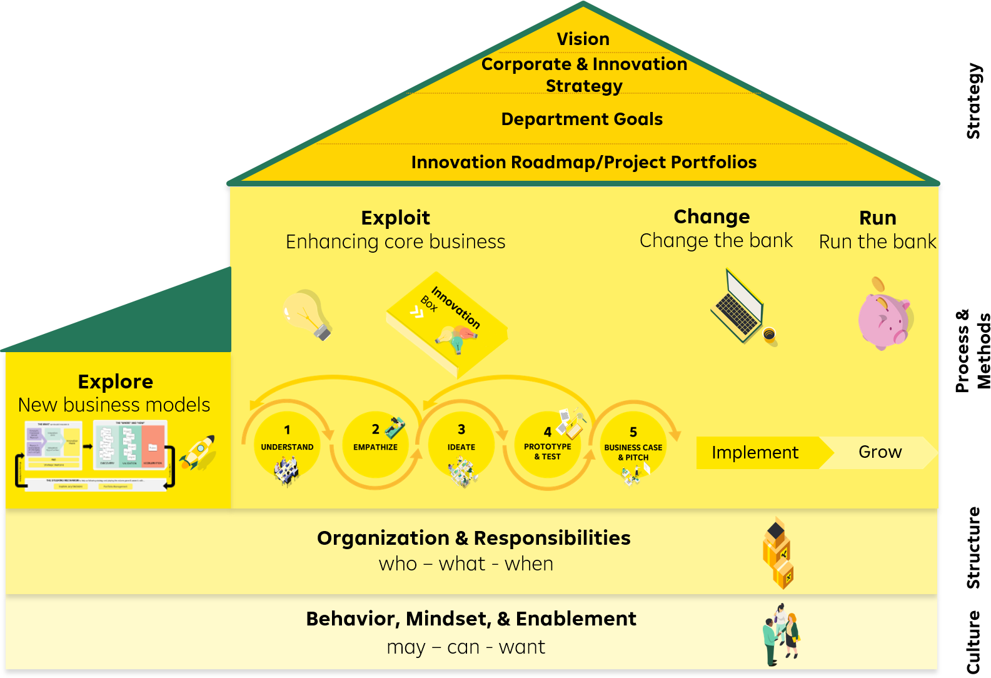
House of Innovation – the Foundation
Innovation Culture

Slide 48

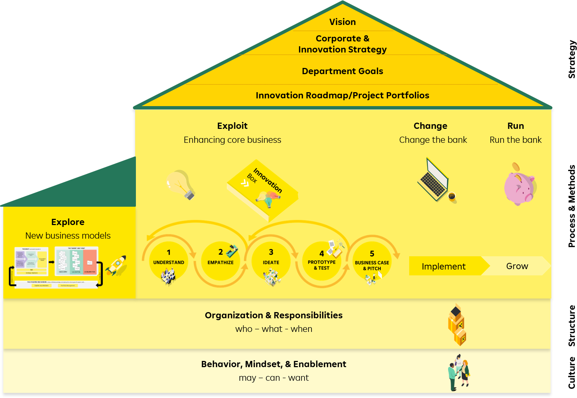









3 Pillars of Culture Work
Innovation Culture
Collaboration
Facilitation
Mindset

Slide 49




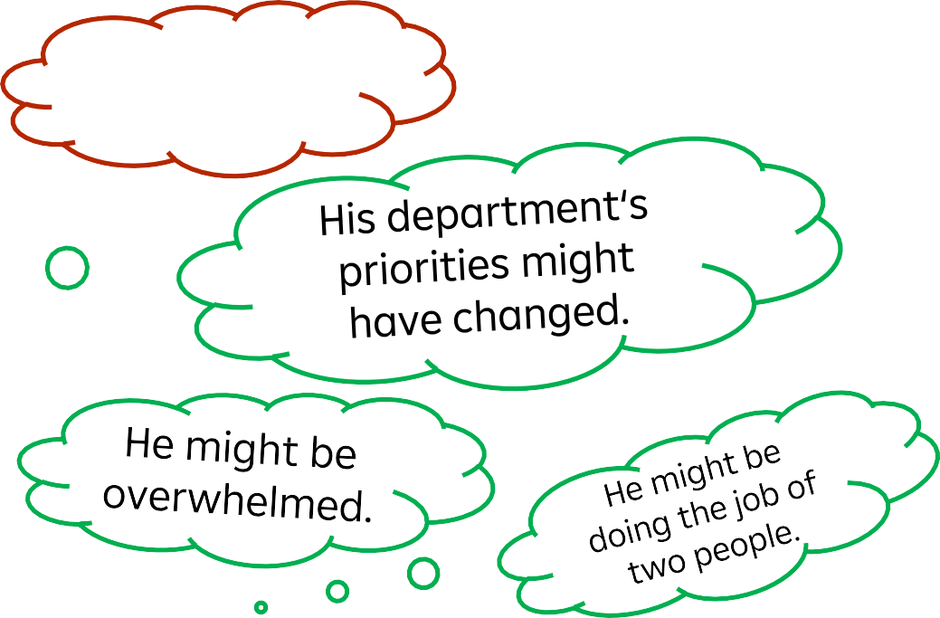



Event
Team Retrospective
Culture
He doesn‘t
like the task.
Peter keeps
missing deadlines.

Slide 50


Trust Requires Knowing Our “Iceberg” and Curiosity
About Others.
Team Retrospective
Missing Deadlines
Behavior
What do we see?
"I don't know which task is most important."
Thoughts & Feelings
What might people be
experiencing?
Negative emotions and behavior are often a sign of unmet personal needs.
Doing Quality Work
Values
What matters here?
Autonomy
Needs
What might be missing?

Slide 51
Peter needs help.
Team Retrospective
Needs
What might be missing?
We might not be able to help him with the root of the behaviour.
Autonomy
What can we do to help tackle the problem?
Thoughts & Feelings
What might people be
experiencing?
Visualise roadmap to
see dependencies.
Align on priorities.
Redistribute the tasks based on availability.
"I don't know which task is most important."
Redistribute the tasks
based on strengths.
Set realistic deadlines.

Slide 52

Innovation Culture Hacks
Team Retrospective
Retrospective
... because strong relationships create a safe space for personal growth, self-efficacy, and creativity. Regularly reflect on your team's work mode to identify areas for improvement.

Slide 53



Team Retrospective
CONTINUE
What should the team CONTINUE doing?

Slide 54
Your Task: Retrospective
Team Retrospective
30
min
Do a retrospective in your team
What works? What doesn’t?
What can you change?
Your coach is facilitating you!

Slide 55
Team Retrospective

Slide 58

STEP 3
Ideate
RBI Innovation Process

Slide 59

RBI Innovation Process
RBI Innovation Process
1
UNDERSTAND
2
EMPATHIZE
3
IDEATE
4
PROTOTYPE & TEST
5
BUSINESS CASE & PITCH

Slide 60
RBI Innovation Process
RBI Innovation Process
1
UNDERSTAND
2
EMPATHIZE
3
IDEATE
4
PROTOTYPE & TEST
5
BUSINESS CASE & PITCH

Slide 61







3
Ideate
Theory

Slide 62
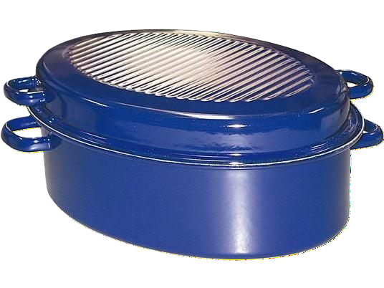

3
Ideate
Theory

Slide 63







Different Mindsets for Working
3
Ideate
Theory
Fixed
Mindset
Innovation
Mindset

Slide 64
But can I be creative enough?
3
Ideate
Theory

Slide 65



Forms of Creativity
3
Ideate
Paintings
Compositions and music
Arts
Content creation
Creativity as a means to an end
Connecting the dots, seeing connections
New solutions for problems
Ideas, concepts
Theory
Aesthetic Creativity
Problem-Solving Creativity

Slide 66


Our Brain…
3
Ideate
… is lazy in its nature
… loves routines
… wants to avoid the unknown to save energy
Theory
But the unknown also has a certain charm – it could mean progress and efficiency, which the brain likes.

Slide 67
But We Can Hack Our Brain…
3
Ideate
… by forcing ourselves to be open towards the unknown
… by establishing a positive failure culture
… by discarding creativity blockers
Theory
… And by using creativity techniques to create a stimulus within the brain

Slide 68
How to stimulate our brain then?
3
Ideate
Theory

Slide 69





Ingredients for Successful Ideation: „Idea Hexagon“
3
Ideate
Problem/Intent
People
Process & Resources
Theory
Atmosphere
Method
Motivation

Slide 70


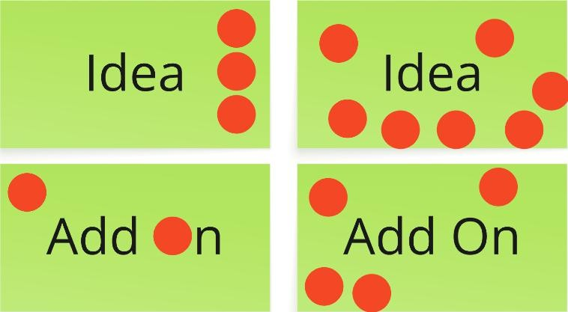
Creativity Workshops Need Proper Methods
3
Ideate
Examples:
Building upon others (Matrix)
Brainwriting & Trigger
Intergalactic Thinking
Theory
On stage & loud (quantity)
In team & relaxed (quality)
In team & structured

Slide 71
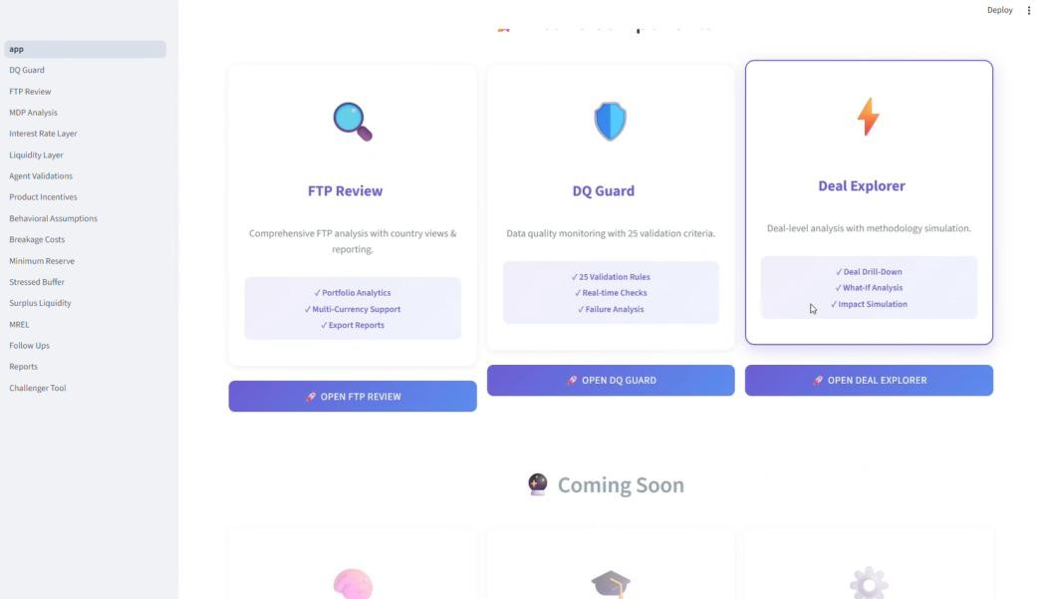

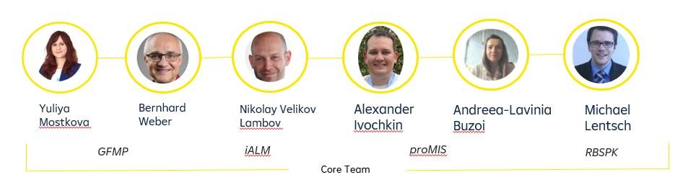
FTP Review Process
3
Ideate
Remember the FTP team from this morning …
Ideate - Step
Team had to come up with ideas to create a solution addressing the vast number of pains
RBI Case Study
Aha-Moment
Applied 2 diffe…rent creativity techniques followed by a clear clustering and summary at the end

Slide 72
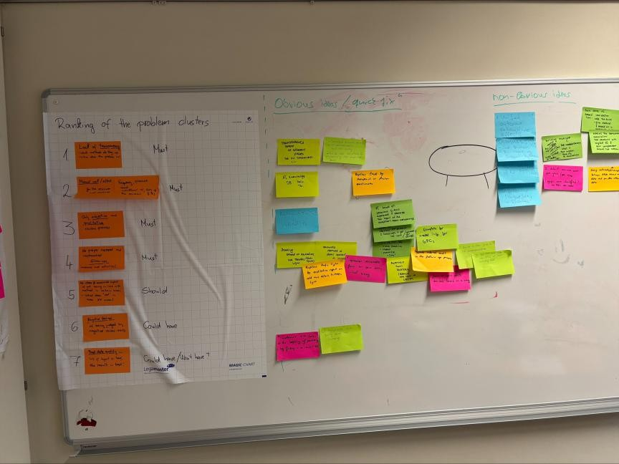
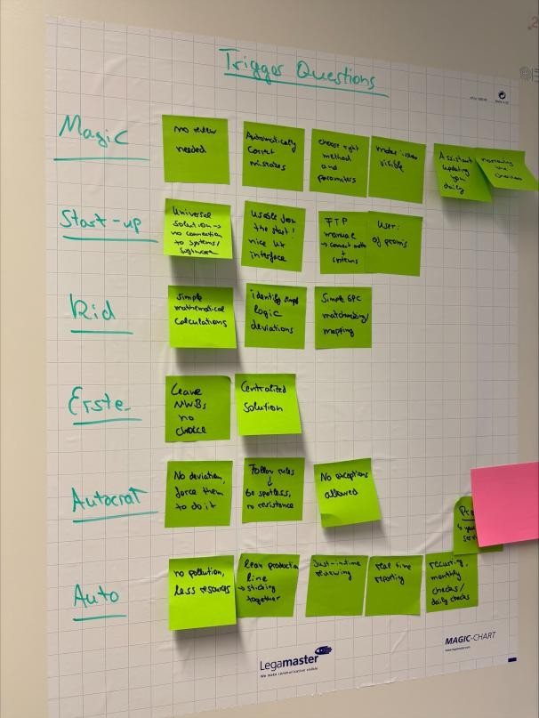
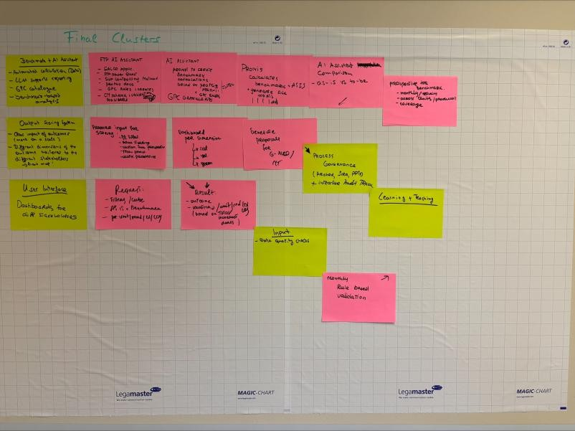
FTP Review Process
3
Ideate
Headstand
Trigger Questions
Combined Clusters & New Process
RBI Case Study

Slide 73


Slide 74


3
Ideate
Brainwriting
(silently, individually)
3
min
Work on it

Slide 75
3
Ideate
Trigger
(silently, individually)
5
min
Work on it

Slide 76

Fin Tech Start Up

Slide 77

6 year old

Slide 78

Magic / Geni

Slide 79

Greta

Slide 80

3
Ideate
2
min
Put ideas on your flipchart
Work on it

Slide 81




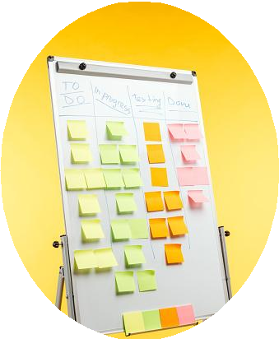









Coaches‘ Facilitation – What is the idea?
3
Ideate
80
min
Intergalactic Thinking
Go through all ideas
Start discussing and clustering your ideas
Vote
Work on it
Detailing your idea
Discuss and answer the following questions with your team
Who is the solution made for? Which pains do they have?
How does the idea work in detail?
How does the new process or user journey look like?
What is the USP and value proposition?
In which way are features of your solution addressing which pain point you discovered?

Slide 82
Ideate in a Nutshell
3
Ideate
Mindset
Let‘s collect lots of ideas without judging - then narrow it down
Work oSunmitmary
Goals
Tools
Find various possible solutions for your
identified problem
Checklist: Ideate
Ideation Workshops
Decide for one or a few favorable directions
Brainstorming, Brainwriting
Specify and visualize your idea, including
the new process
Trigger Questions
Intergalactic Thinking
Dot Voting

Slide 83

How to Use AI in RBI
3
Ideate
Let AI generate ideas
Give the LLM the context and clear problem and let it come up with a list of ideas – often you can build up on them
Create an Ideation Workshop Concept
Use AI to structure your planned ideation workshop and give you method suggestions if you are stuck
Work oSunmitHmoawryto use AI
Treat the AI as workshop participant
Do a more guided ideation with AI by applying, for example, intergalactic thinking or trigger questions with it
Cluster or Challenge ideas
Ask the AI to cluster a list of ideas or challenge your ideas on weak spots

Slide 84

3
Ideate
Trigger
Whenever you are about to conduct or participate an ideation sessions
Work oSunmitHmoawryto usHeaAbIits

Slide 85

3
Ideate
Desirable Step
Apply the “no ideation without a clear problem statement” mentality and define a problem or area within which you ideate as precisely as possible
Work oSunmitHmoawryto usHeaAbIits

Slide 86

3
Ideate
Habit-Stacking
Make it a rule within your team and always ask organizers when you are supposed to participate
Work oSunmitHmoawryto usHeaAbIits

Slide 87
Take your time and note down habits that you are planning to immediately implement after innovation school regarding this first step.
3
Ideate
Work oSunmitHmoawryto usHeaAbIits
Page 40

Slide 88
3
Ideate

Slide 91
Resilience
The Art of Self-Hosting

Slide 92


What's Happening Inside?
Resilience
Often, we let our body's signals pass unnoticed. Let's check!
Body Battery
Mental Fatigue
Stress Level
Scale 1-10
Scale 1-10
Scale 1-10

Slide 93
Fatigue?
Resilience
I power through!

Slide 94

Managing Stress
Resilience
Eustress (positive)
Distress (negative)
Felt motivating and energizing during the initial ideation phase.
After the 4th back-to-back meeting, eustress may shift into overwhelming stress.

Slide 95

Managing Stress
Resilience
Nobody has a great idea when they’re being chased by a lion.

Slide 96









Mini Self-hosting Principles
Resilience
Notice
Name
Nudge/Do
Breath
Body
Boundaries

Slide 97
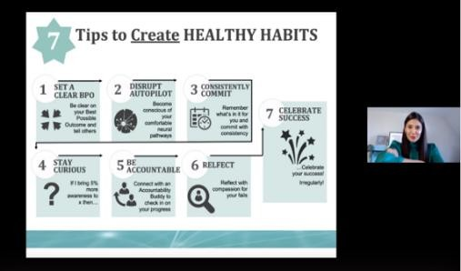



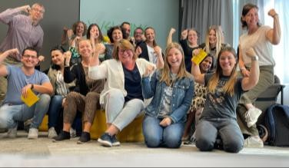
Offers in the Resilience Learning Initiative
Resilience
Get inspired
Learn new
Learn more
Apply
Change
Online Curiosity Training
Resilience WorkOuts
Resilience Deep Dive Playlist
Regulate with us - Breathwork program
Resilience Learning Journey
When you’re curious or just starting out, learn from external experts. Recordings available.
When you want to build solid foundations through online learning and peer exchange. *
When you’re ready to dive deeper into resilience topics through online learning.
When you want to develop a lasting habit that boosts your performance, well-being, and resilience. *
When you’re committed to a full transformation. Designed for advanced learners and leaders.*
Quarterly 1 hour, recoding: 1 hour each
4-5h
2-3h each
3-4h per month over 6 months
Approx. 70h over 6 months
* Head office ony

Slide 98







Make It Practical: Your Self-hosting Plan
Resilience
When I notice X, I will Y.
My 2-minute reset: …
One boundary this week: ….

Slide 99






Your Task: Mini Self-hosting
Resilience
Between our onsite days here and the next online day on Nov 4th:
Check in with yourself regularly
→ You can do the mini hosting anytime in your day-to-day
Check
page 42!
But do it deliberately before doing your homework exercise (more on that on Day 4)

Slide 100
Resilience

Slide 101








Reflection time
Let‘s reflect on today‘s experience with the handbook!

Slide 102
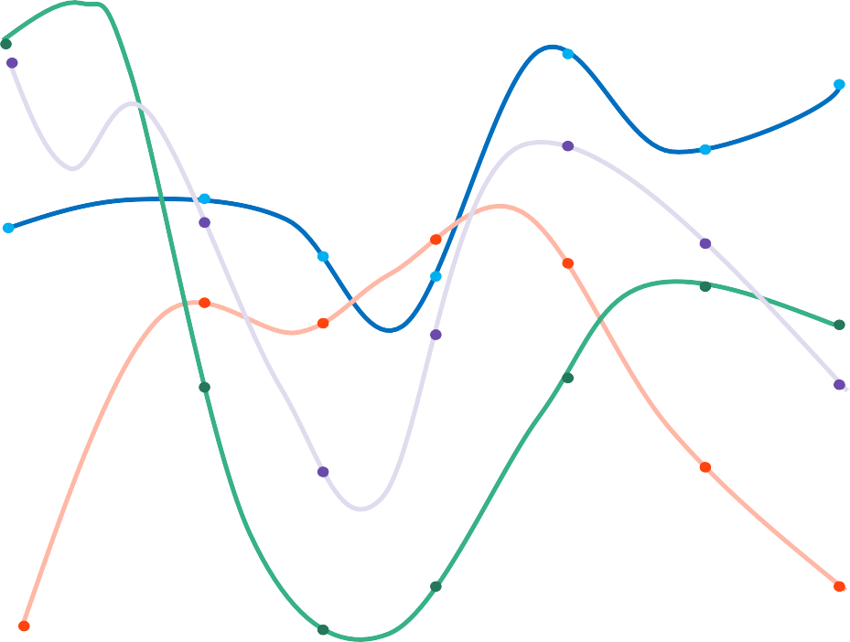
Team Energy Chart
Reflection
My energy level
-- 100%
Interviews | Break | Synthesise | Lunch | Retro | Ideation | Resilience

Slide 103
















Reflection
Reflection
Mindset
Collaboration
Facilitation
What mindsets seemed to create energy today?
How did other people influence energy today?
What in the design of the day influenced energy?
page 43

Slide 104

Reflection
What is one small thing you could bring into your own work environment next week to create, protect, or restore energy?

Slide 105

Closing our second day in Budapest

Slide 106
Closing

Slide 107


Slide 108


Slide 109

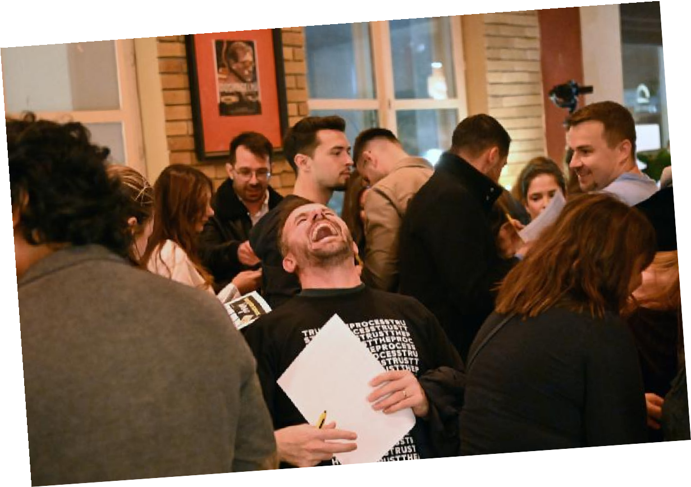

Slide 110
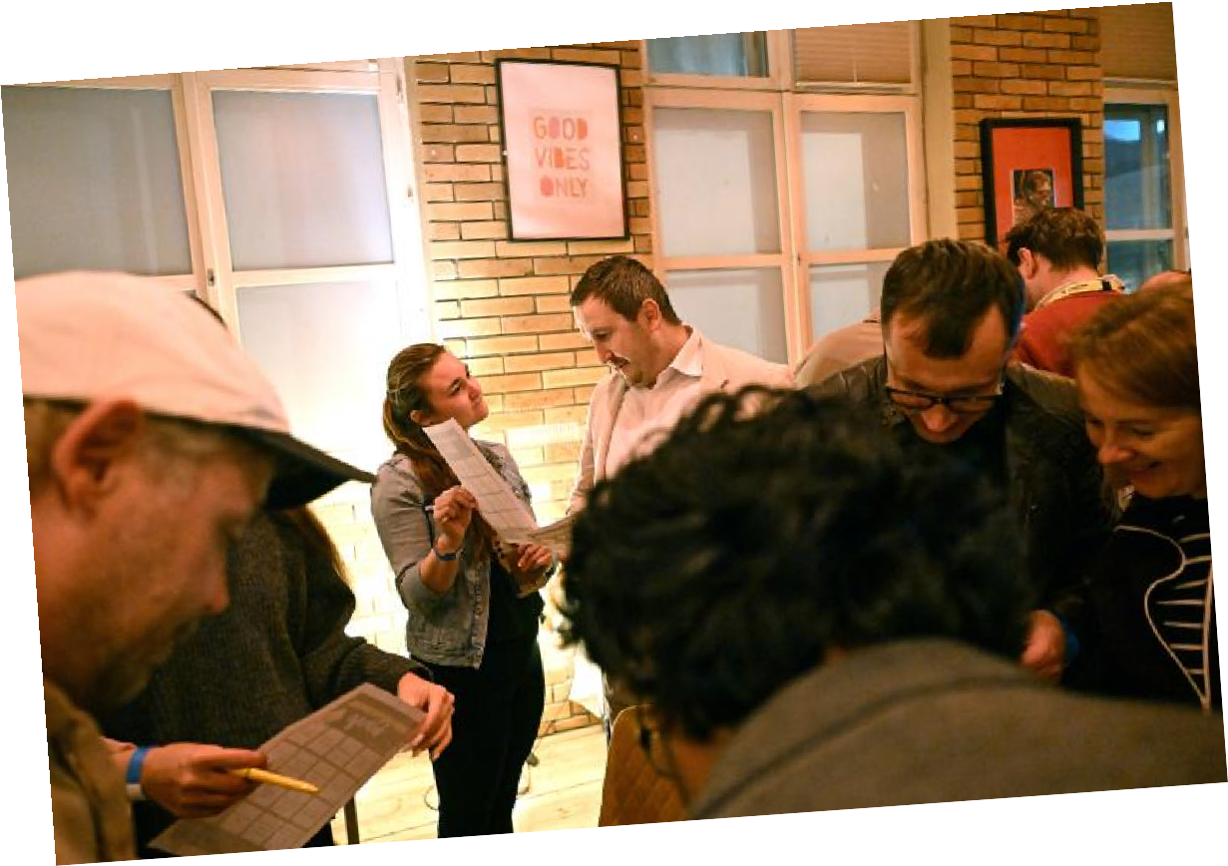

Slide 111
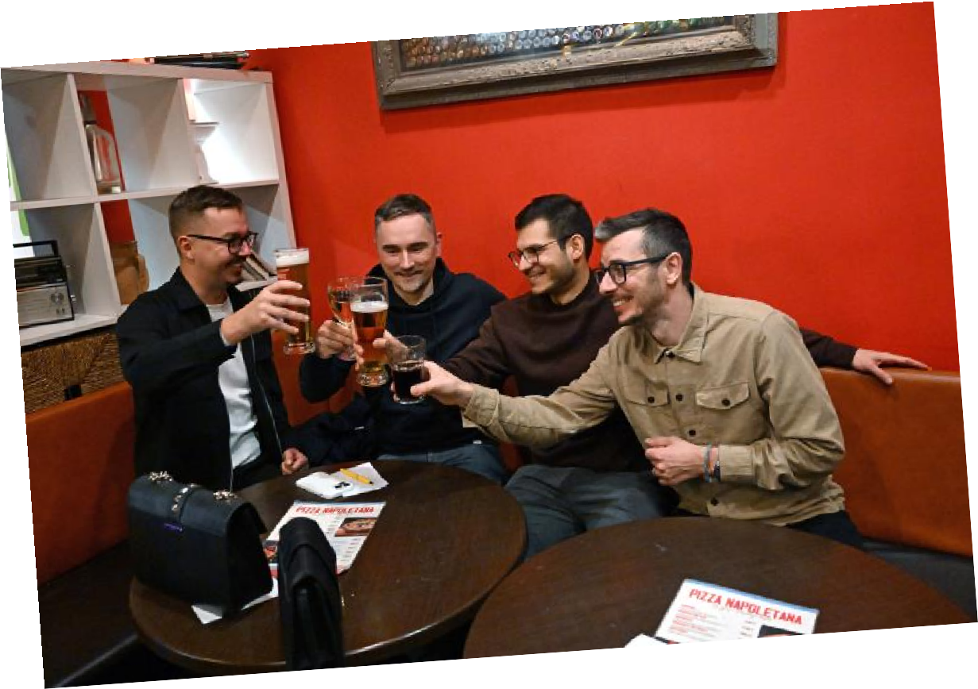

Slide 112
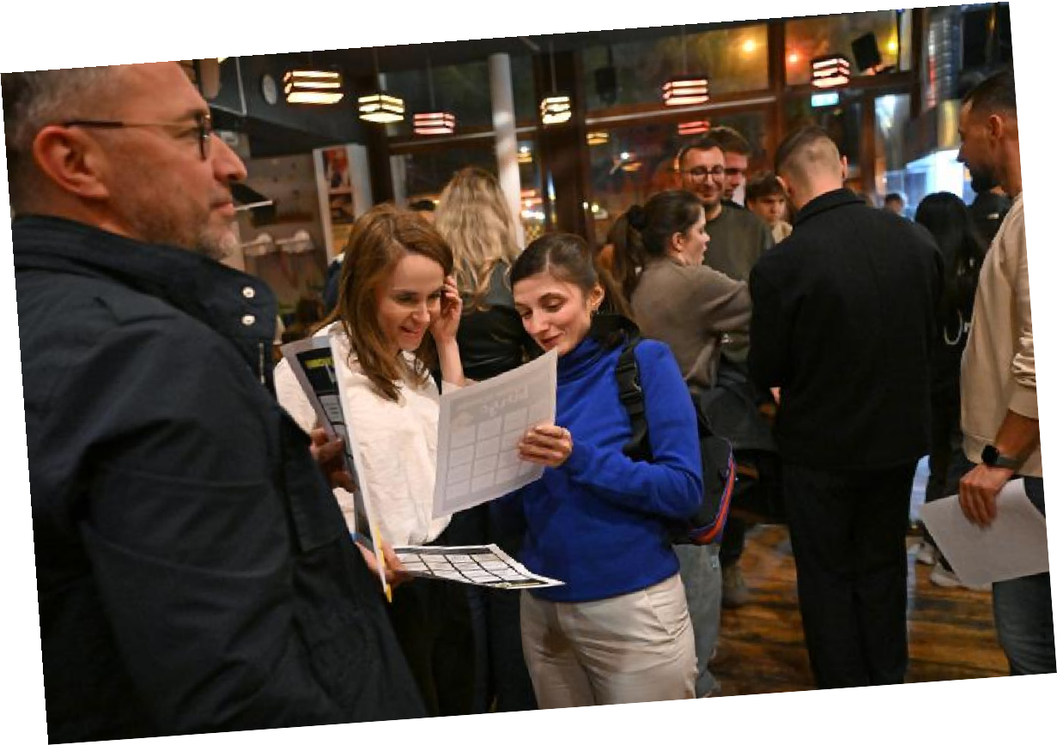

Slide 113
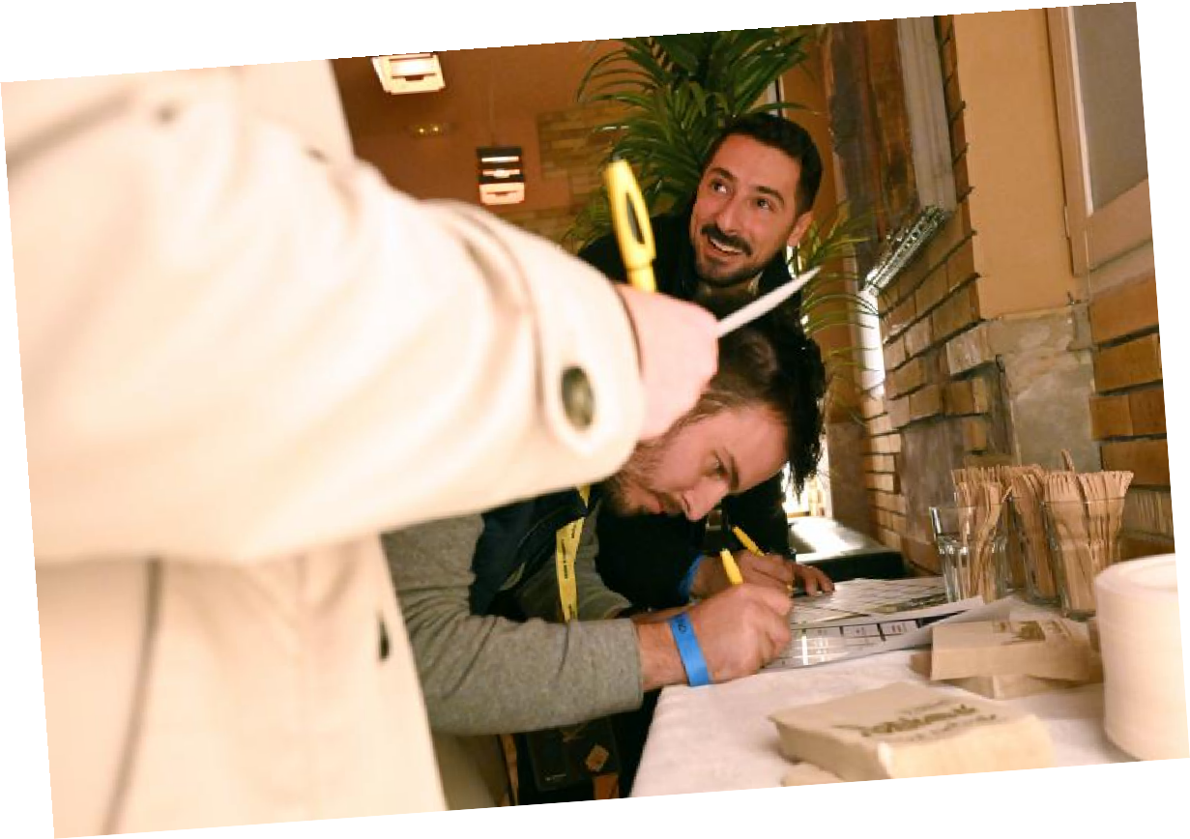

Slide 114

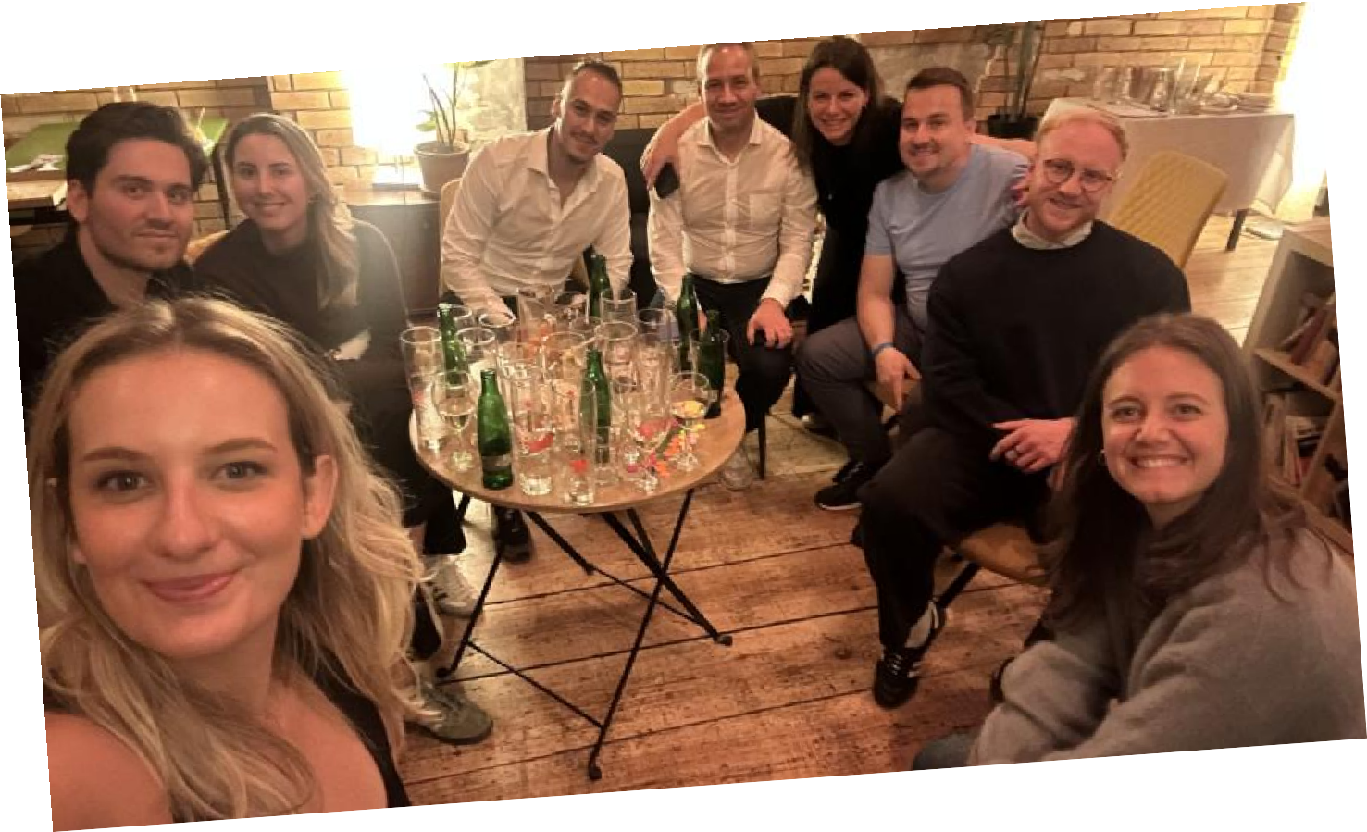

Slide 115
What We Did Today
Closing
Online
Wed | 30.09.
09:00
Welcome
Innovation
Challenge
Learning Transfer
Individual Homework
Closing
12:30
Budapest
Wed | 14.10.
09:00
Online
Wed | 04.11.
09:00
Welcome
Key Takeaway Presentation for Line Managers
Learnings
Reflection Closing 12:30
Follow Up
Wed | 15.12.
09:00
Welcome
Personal & Team Check-In
Alumni Meetup
Reflection Closing 11:00
Tue | 13.10.
08:30
Opening
Innovation Theory Teaming
Lunch Break
Design Thinking
Reflection
18:00
19:00
Welcome Night
Thu | 15.10. Fri | 16.10.
09:00 09:00
Workmode Reflection
Design Thinking
Individual Homework
Lunch Break Lunch Break
Culture Individual Homework
_{Design} Facilitation Thinking
Innovation SPOC Session
Reflection _{Reflection}
Welcome from _{16:00} RBHU
18:00
18:45
Boat Cruise
Break
Individual Homework & preparation for the Key Takeaway Presentation
Break
Transfer and apply the learnings
Break
on & Innovation Challenge Research
Design Thinking
Lunch Break
Culture
Learning Transfer Expectati
Design Thinking
Reflection
18:00

Slide 116
What To Expect Tomorrow
Closing
Online
Wed | 30.09.
09:00
Welcome
Innovation
Challenge
Learning Transfer
Individual Homework
Closing
12:30
Budapest
Thu | 15.10.
09:00
Online
Wed | 04.11.
09:00
Welcome
Key Takeaway Presentation for Line Managers
Learnings
Reflection Closing 12:30
Follow Up
Wed | 15.12.
09:00
Welcome
Personal & Team Check-In
Alumni Meetup
Reflection Closing 11:00
Tue | 13.10. Wed | 14.10.
08:30 09:00
Opening
Design
Innovation Theory _{Thinking}
Teaming
Lunch Break Lunch Break Culture
Design
Thinking Design
Thinking
Reflection Reflection
18:00 18:00
19:00
Welcome Night
Fri | 16.10.
09:00
Workmode Reflection
Individual Homework
Lunch Break
Individual Homework
Facilitation
Innovation SPOC Session
Reflection 16:00
Break
Individual Homework & preparation for the Key Takeaway Presentation
Break
Transfer and apply the learnings
Break
on & Innovation Challenge Research
Design Thinking
Lunch Break
Culture
Learning Transfer Expectati
Design Thinking
Reflection
Welcome from RBHU
18:00
18:45
Boat Cruise

Slide 117
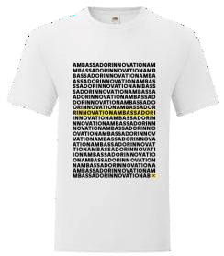










Reminders
Wear your Innovation T-shirt tomorrow
Bring your laptop tomorrow!
Bring your handbook
There will be no time to return to the hotel tomorrow, as the evening event starts at 18:45.

